Slide 1
Checkup Visualization on Heart Disease Targets
Projection of Data on Heart Disease to the checkup team in cardiology department

Slide 2
Projection of Data on Heart Disease to the checkup team in cardiology department
Healthcare Data on Heart Disease:
Data has been taken from: https://www.kaggle.com/ronitf/heart-disease-uci
Visualizations on various features of the data to the Checkup team who are most likely targets of heart disease.

Slide 3
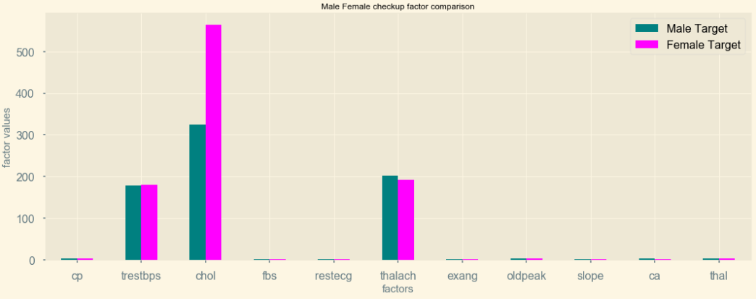
Graphs on male individuals potentially target for heart diseases

Slide 4
Characteristics obtained from the graph in both male and female individuals who are targets of heart disease
cholesterol levels are above 300 for male and above 500 for female
restbprs is between 170 and 180 and max is 178
thalach is seen up to max 190 and above
Most of the other features are seen similar.

Slide 5
Inferences from the male/female data points on heart disease.
Individuals coming for the checkups having trestbps>170 have likely chances to have high cholestrol
If cholesterol in male is more than 300 and in female it is more than 500 are highly potential targets for Heart disease.
Step 1
Male (trestbps>170)
Female (trestbps>170)
Step 2
Chol>300
Chol>500
Step 3
Heart disease targets
Heart disease targets

Slide 6

Thank You
Trishala Basti ( Student of ELU)
Module2 Project

